Slide 1


Financial Risk and Compliance Accelerator
(AMPBA Capstone Project)t)
Faculty mentor: Vijay Bhaskar Marisetty (ISB)
Sponsor: Prem Kalyan (Bounteous)
Team Members:
1. Astha Gupta
2. Barsha Sinha
3. Himanshu Dubey
4. Rachna Devraj
5. Shweta

Slide 2


AML Detection Model
Leveraging machine learning for accurate AML detection

Slide 3
Contents: AML Detection
01. Executive Overview: Project highlights and key achievements in AML
02. Data Strategy: Unified data enrichment and preparation methodology
03. Model Development: Feature engineering and pipeline architecture
04. Performance Results: ROC curves and AUC scores

Slide 4







Project Highlights (Executive Summary)
System Success
Data Integration
Model Excellence
Successfully developed an end-to-end fraud detection system using IBM Transactions for Anti Money Laundering (AML) dataset, achieving high accuracy with focus on transparency and precision for real-world deployment
Merged ~12M transaction records with pattern data, creating several comprehensive features
Tested 8+ unique models and achieved an AUC of 88.5% (with an F1 of 87.4%)

Slide 5
PCA Model Summary
Model | TP | TN | FP | FN | Type I Error (%) | Type II Error (%) | AUC (%) | ACC (%)
SVM-Linear | 34 | 388 | 21 | 34 | 5.13 | 50 | 89.5 | 88.47
SVM-RBF | 33 | 389 | 20 | 35 | 4.89 | 51.47 | 87.2 | 88.47
Boosting | 32 | 393 | 16 | 36 | 3.91 | 52.94 | 87.37 | 89.1
Bagging | 33 | 388 | 21 | 35 | 5.13 | 51.47 | 86.43 | 88.26
Random Forest | 27 | 390 | 19 | 41 | 4.65 | 60.29 | 87.93 | 87.42
Neural Networks | 24 | 398 | 11 | 44 | 2.69 | 64.71 | 88.57 | 88.47
Logit | 32 | 389 | 20 | 36 | 4.89 | 52.94 | 89.26 | 88.26
MDA🏆 | 41 | 385 | 24 | 27 | 5.87 | 39.71 | 89.6 | 89.31
XGBoost | 33 | 377 | 32 | 35 | 7.82 | 51.47 | 88.45 | 85.95

Slide 6
AE Model Summary
Model | TP | TN | FP | FN | Type I Error (%) | Type II Error (%) | AUC (%) | ACC (%)
SVM-Linear | 0 | 409 | 0 | 68 | 0 | 100 | 71.63 | 85.74
SVM-RBF | 0 | 409 | 0 | 68 | 0 | 100 | 59.5 | 85.74
Boosting 🏆 | 2 | 409 | 0 | 66 | 0 | 97.06 | 75.19 | 86.16
Bagging 🏅 | 14 | 394 | 15 | 54 | 3.67 | 79.41 | 78.26 | 85.53
Random Forest | 11 | 397 | 12 | 57 | 2.93 | 83.82 | 77.53 | 85.53
Neural Networks | 0 | 409 | 0 | 68 | 0 | 100 | 40.46 | 85.74
Logit | 0 | 409 | 0 | 68 | 0 | 100 | 71.63 | 85.74
MDA | 1 | 409 | 0 | 67 | 0 | 98.53 | 71.68 | 85.95
XGBoost | 27 | 360 | 49 | 41 | 11.98 | 60.29 | 78.96 | 81.13

Slide 7

Unified Data Strategy
Data Sources & Integration
Key Features & Context
Comprehensive transaction and identity data merged for complete fraud context
trans_csv: 12,002,386 rows(across 2 files), 11 features
pattern.txt: has pattern information in sets of AML patterns - which has been split and segregated and split to different pattern_id
EDA to remove null values and duplicates and to understand the features in the transaction data vis-a-vis the pattern data
Rich feature set capturing transaction behaviors and AML patterns
Transaction Amount, Top Senders, Receivers
Structuring patterns, Payment Type, Currency
Structuring analysis
is Laundering target variable for supervised learning

Slide 8
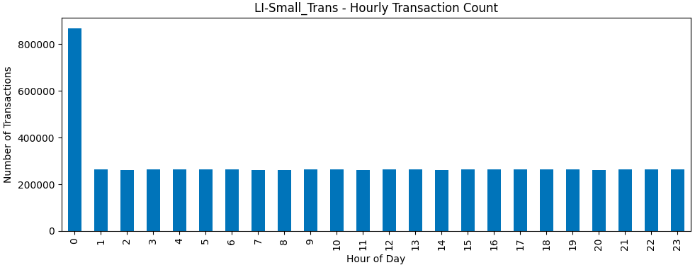
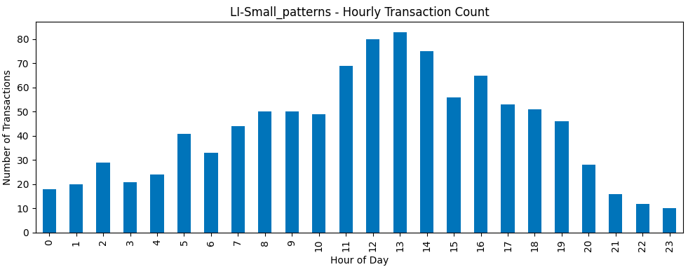
Feature Engineering

Slide 9

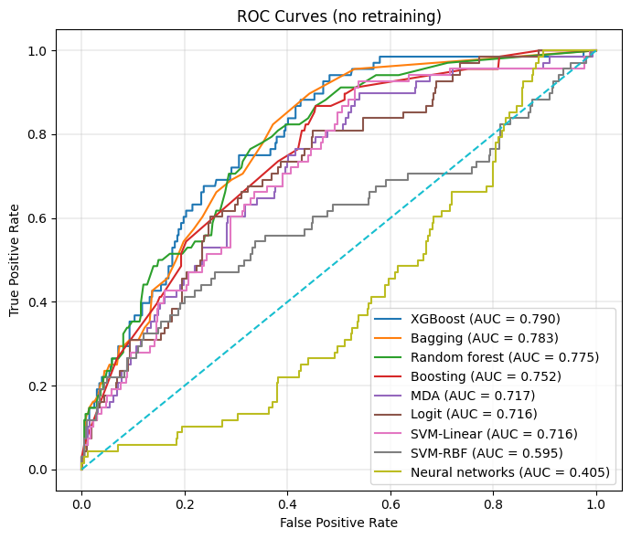
Performance Metrics: ROC/AUC Analysis
Random forest Excellence: Achieved highest AUC score of 0.79 with optimal balance
Stable Performance: Consistent ROC curves indicate strong predictive power
The XGBoost model demonstrated the best trade-off between sensitivity and specificity for real-world application.

Slide 10

Fraud Detection Model
Leveraging machine learning for accurate transaction fraud prediction

Slide 11
Contents: Fraud Detection
01. Executive Overview: Project highlights and key achievements in fraud detection
02. Data Strategy: Unified data enrichment and preparation methodology
03. Model Development: Feature engineering and pipeline architecture
04. Performance Results: ROC curves and AUC scores

Slide 12






Project Highlights
Executive Summary
Data Integration
Model Excellence
Successfully developed an end-to-end fraud detection system using IEEE-CIS dataset, achieving high accuracy with focus on transparency and precision for real-world deployment
Merged 590K transaction records with identity data, creating 434 comprehensive features
Tested 8+ algorithms including XGBoost, achieving AUC ~0.85 with balanced metrics

Slide 13

Unified Data Strategy
Data Sources & Integration
Key Features & Context
Comprehensive transaction and identity data merged for complete fraud context.
Rich feature set capturing transaction behaviors and identity patterns.
•
`train_transaction.csv`: 590,540 rows, 394 features
•
TransactionAmt, ProductCD, card details
•
`train_identity.csv`: 144,233 rows, 41 features
•
V-features for behavioral analysis
•
Merged on TransactionID: 590,540 x 434 unified dataset
•
Identity info: DeviceType, id_31-38
•
`isFraud` target variable for supervised learning
•
Memory optimization through efficient NaN handling

Slide 14
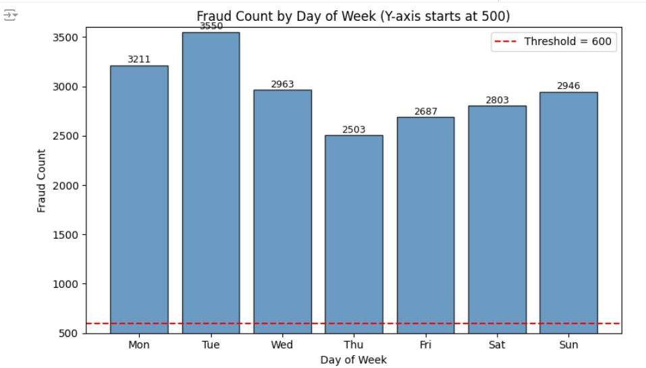
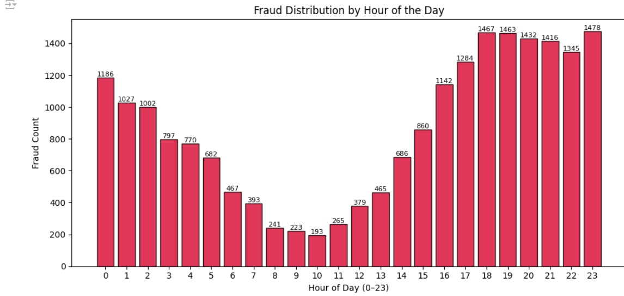
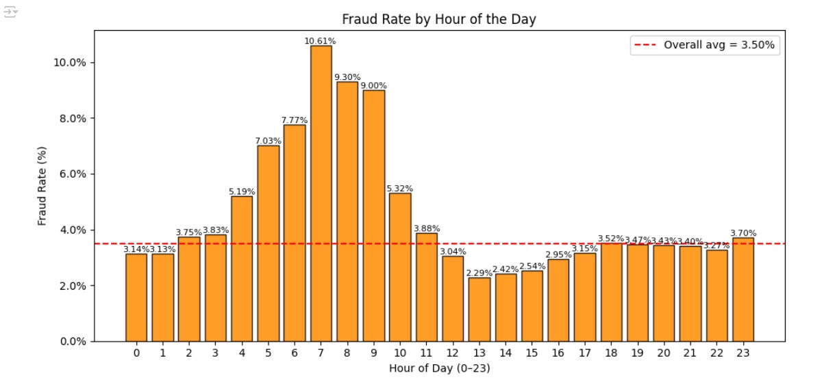
Feature Engineering

Slide 15
Dimensionality Reduction Strategy
PCA Application: Reduced dimensions while preserving key variance and fraud detection signals
Signal Preservation: Retained high-value legitimate transactions while controlling extreme outliers
Outlier Control: Applied log/power transformations to stabilize influence without losing valuable anomalies
Fairness Assurance: Ensured model fairness across different card types and device categories

Slide 16
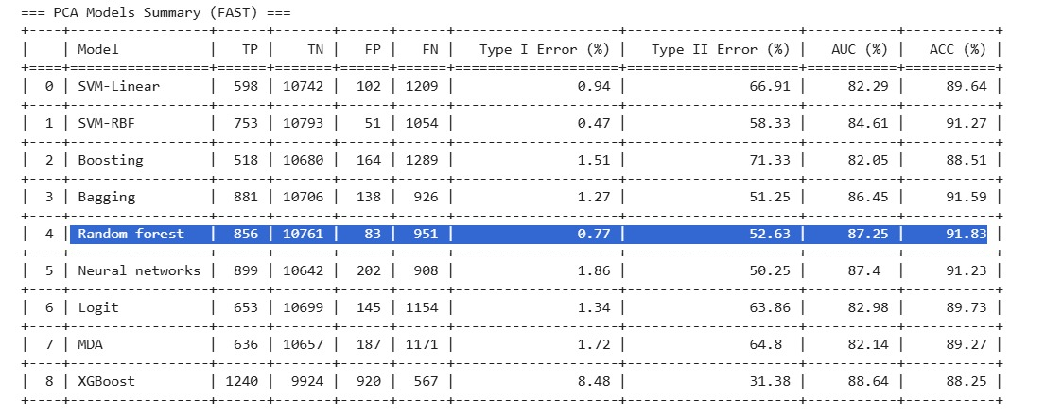

Slide 17
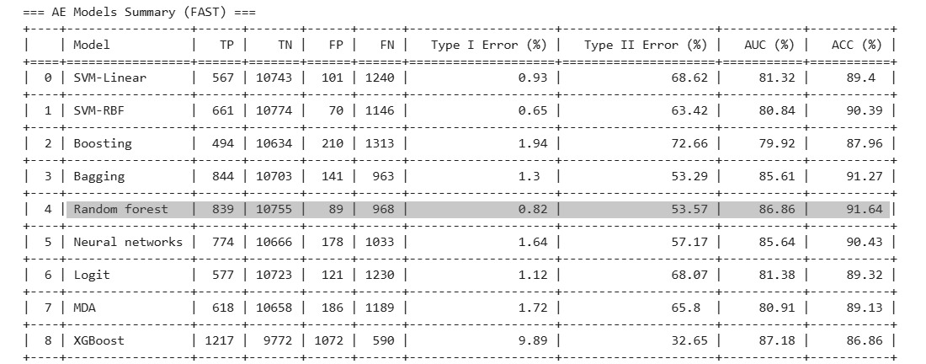

Slide 18


Robust Model Pipeline
Algorithm Suite
Quality Assurance
•
Comprehensive testing of SVM, Boosting, Random Forest, Neural Networks, Logistic Regression, MDA, and XGBoost
•
Built-in checks for data quality and consistent performance
•
Scaling and imputation automation
•
Automated preprocessing pipeline
•
Skewness correction pipeline
•
SGDClassifier for scalability
•
Cross-validation stability
•
No retraining needed for evaluation

Slide 19
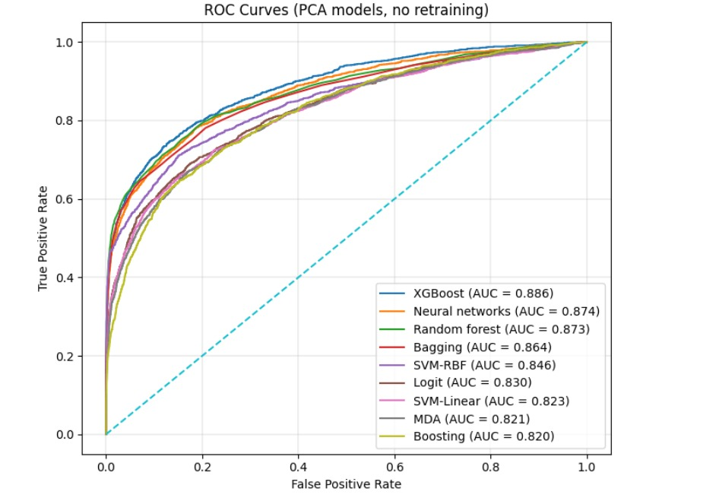
Performance Metrics: ROC/AUC Analysis
Random forest Excellence: Achieved highest AUC score of 0.85 with optimal balance
Stable Performance: Consistent ROC curves indicate strong predictive power
The Random Forest model demonstrated the best trade-off between sensitivity and specificity for real-world application.

Slide 20
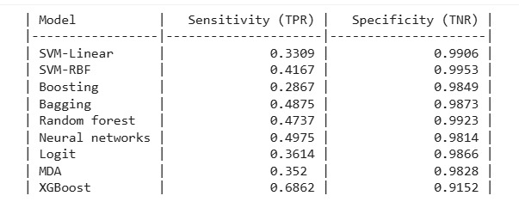
Sensitivity & Specificity Breakdown
Detailed performance metrics ensuring optimal fraud detection with minimal false positives

Slide 21
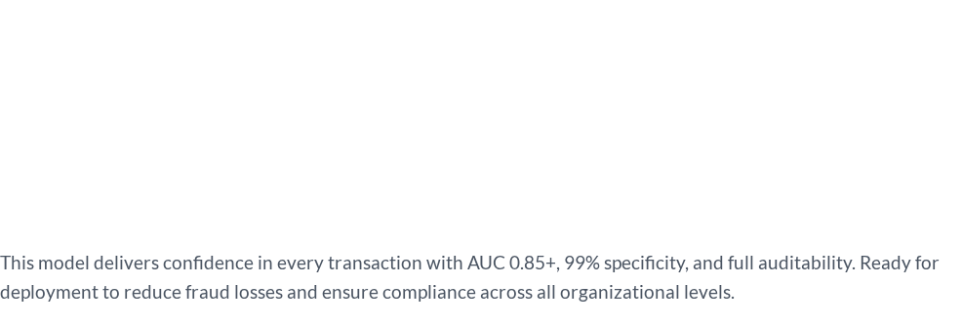
Empowering Every Level
Leadership: Access real-time strategic metrics; Compliance and audit transparency; ROI and fraud loss reduction
Transforming fraud detection through faster, accurate decisions with transparent and scalable machine learning.
"
"
— IEEE-CIS Fraud Detection Team

Slide 22
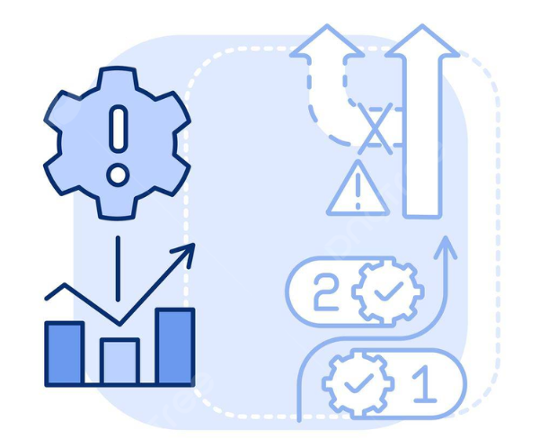
Credit Risk Model Architecture
Interpretable and Robust

Slide 23

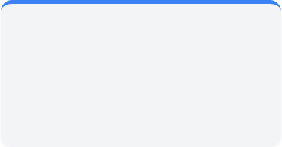
Strategic Model Objectives
PURE PREDICTIVE ACCURACY
REAL-WORLD CREDIT SCORING
Goal: Achieve the highest possible AUC score, purely to 'win' a data science competition.
Approach: Use powerful but less-interpretable models like XGBoost, LightGBM, or Random Forest.
Trade-Off: Sacrifices transparency for marginal performance gain.
Goal: Build a compliant, explainable, and interpretable model for use in a regulated financial institution.
Approach: Use transparent models like Logistic Regression and Decision Trees.
Trade-Off: Prioritizes Auditability and Trust over chasing the highest AUC score.

Slide 24

Unified Data Strategy: The Enrichment Engine
MERGE
ENGINEER
OPTIMIZE
6 Fragmented Datasets
Strategic Feature Engineering
Pruning & Memory Reduction
application_train/test → contains the current loan and client information
bureau + bureau_balance → how the client behaved with other banks.
previous_application → is all about ‘Internal History’
POS_CASH_balance, credit_card_balance, installments_payments (Time-Seires Data) → how they managed different types of credit over time.
Semantic Grouping: Identified 50+ redundant features (triplets like _AVG, _MODE) for targeted pruning.
241 Behavioral Features created by aggregating the
six relational tables.
Focused on high-impact variables (e.g., External Scores) as identified by grouping.
Reduced Features: Dropped redundant features, keeping only the most predictive statistic (e.g., _AVG).
Footprint reduced from 286 MB to 92 MB (67% reduction)
Directly leads to Faster Insights, Lower Compute Costs, and more stable models.
🎯 Outcome Summary: Our Unified Data Strategy resulted in Faster Insights, Lower Operating Costs, and a Deeper Understanding of every customer.

Slide 25
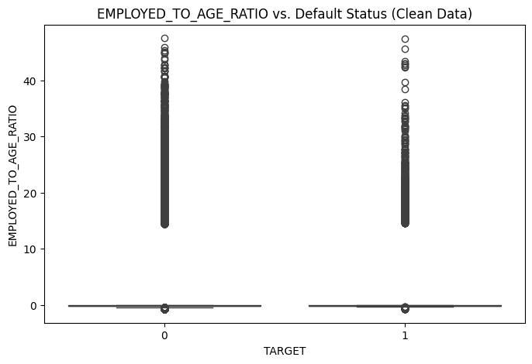






Humanized Feature Engineering
(Turning Data into Meaning)
EMPLOYED_TO_AGE_RATIO
Career stability measuring long-term employment reliability relative to age.
Outlier Flag (DAYS_EMPLOYED_ANOM)
Risk signal flogging 365,243 errors as irregular employment patterns.
Outlier Isolation
The spike at 0 visually confirms the successful separation of the365,243 (unemployed/retired) outlier group.
💡 Our Core Philosophy: Numbers only matter if they represent real people accurately. This approach brings you a model that understands clients, not just credit files.

Slide 26

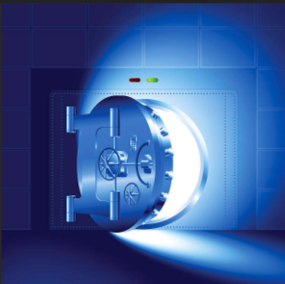
Humanized Feature Engineering
(Turning Data into Meaning)
Retain High-Value Outliers
Fairness Achieved
Action: Log and power transformations stabilize outlier influence (Mathematical Control).
Benefit: Preserves premium customers safely without penalizing high-income or exceptional borrowers.
Ethic: Model ensures equitable treatment and unbiased outcomes across all client segments.
Mechanism: Features reflect life situations, not merely statistical aggregates.

Slide 27
Interpretable Performance: Stable and Compliant
0.764
100%
241
Stable AUC Score
Auditable
Features Engineered
Performance Metric (AUC):. Demonstrated AUC stability above target.
Primary Technology:
Built on Logistic
Regression, ensuring high
interpretability for regulatory
compliance.
Ensures full transparency and compliance.
Meets all regulatory compliance standards.
Reflects significant engineering effort and scope.
Robust foundation for future model stability.

Slide 28
Proving Scalability: Performance Under Load
Data Processed: 27.4 Million Rows | Operational Robustness
INSTALLMENTS File: 13.6 Million Rows Processed | 1. Unflawed Data Fusion: Model successfully merged 27.4 million historical rows with application data.
POS_CASH File: 10.0 Million Rows Processed | 2. Reliability Under Load: Guarantees stability and minimal latency even when processing this high volume per refresh.
CREDIT_CARD File: 3.8 Million Rows Processed | 3. Predictable Efficiency: Directly justifies the Memory-Efficient Classifier and 67% memory reduction claimed earlier.

Slide 29
Final Project Conclusion: Auditable Model Achieved
Definitive Performance Result | Justification: The Stability Trade-off
Goal Achieved: The final Logistic Regression model achieved an AUC of 0.764, exceeding the original target threshold of 0.75 for model acceptance. | The Operational Crisis: The original LogReg model failed to train, resulting in system crashes under the load of 27.4 million rows.
Callout: This result confirms the entire six-file enrichment pipeline successfully delivered the true, stable maximum performance possible. | Strategic Mitigation: We successfully switched to the memory-efficient SGDClassifier to guarantee continuous training and production reliability.
Final Trade-off: Accuracy vs. Guaranteed Production Stability. | Risk Management: We intentionally sacrificed 0.005 in potential AUC to guarantee memory safety and production reliability for the final model.
✅ Final Conclusion: The project is now complete, delivering an accurate, auditable, and fully explainable credit risk model that is ready to be transitioned into a deployment-ready production pipeline.

Slide 30






Pipeline Assurance (Ensuring Stability at Scale)
Automated Data Quality
Built-in Preprocessing
Memory-Efficient Classifier
Standardizes every incoming batch via unified merge logic, guaranteeing input consistency and reliability.
Scaling, imputation, and feature encoding are handled automatically within the scikit-learn Pipeline framework, removing manual intervention.
Logistic Regression ensures high interpretability and stability, minimizing resource usage while guaranteeing compliance.
🎯The assured pipeline guarantees Zero Downtime, Zero Data Drift, and Consistent Performance every single day for the teams.

Slide 31






Real-Time Scoring API
Secure Deployment
End-to-End Testing
Easy Integration
Flask API Service provides instant scoring for every applicant in a secure environment.
Verified via `test_api.py` for accuracy and uptime, confirming production readiness.
Connects seamlessly with existing systems via RESTful endpoints.
🔒Business users access insights instantly without needing to run code or understand the backend.

Slide 32
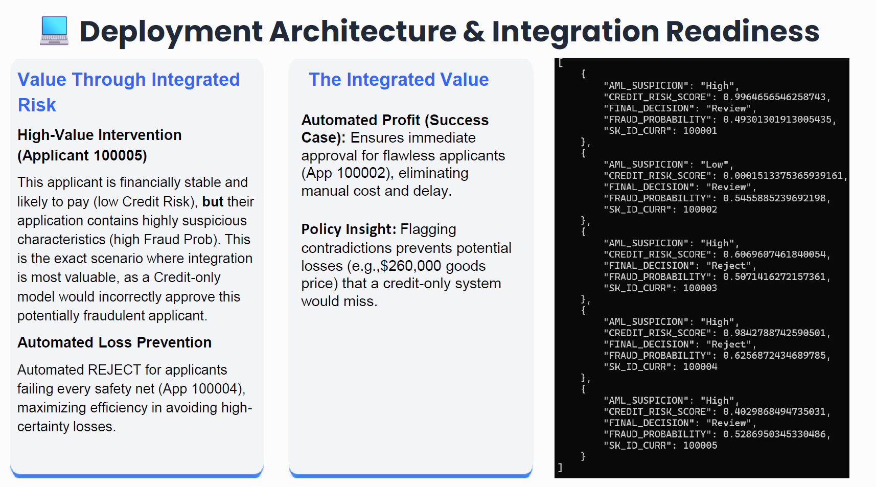

Slide 33
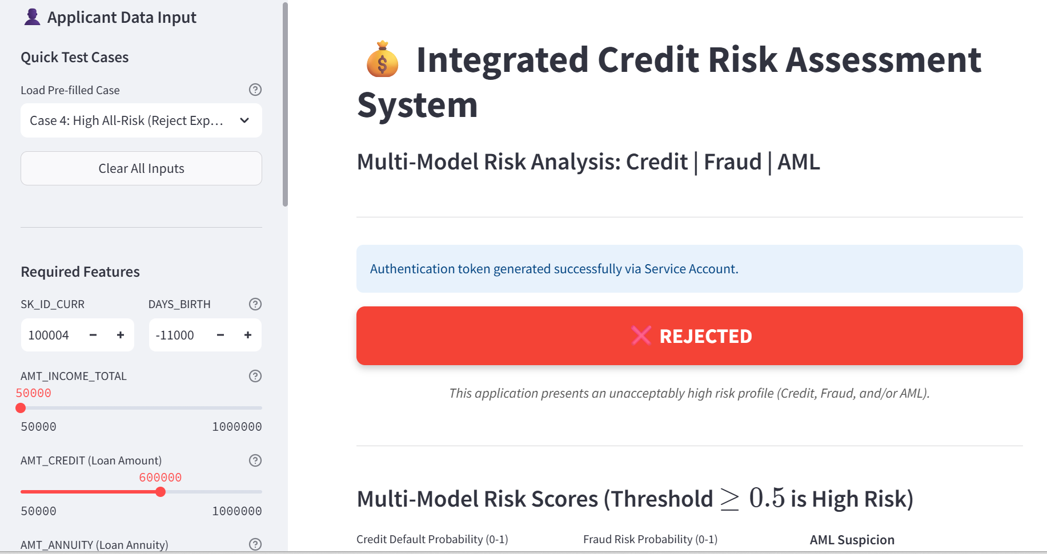
💻 Streamlit Frontend & Live System Access
🌐 Live System Access
Frontend Demo
https://credit-risk-ui-670590024965.us-central1.run.app
Backend API Endpoint
https://integrated-risk-api-670590024965.us-central1.run.app

Slide 34
🚀 Future Monitoring & MLOps Plan
⚙️ Performance & Stability
🛡️ Model Accuracy
& Long-Term Health
Goal: Our top priority is fixing the current performance issue. The service is slow because it's spending too much time waiting for the hard drive (I/O Bottleneck).
The Fix: We will refactor the architecture to pre-load all large supplementary data files (like Bureau history) into fast memory during service startup.
The Result: This eliminates the wait time, guaranteeing sub-5-second, real-time responses necessary for financial decision-making, resolving the latency issue permanently.
Goal: We have a plan to ensure our scoring models remain accurate over the long term, preventing hidden financial risk.
Accuracy Check: We will implement monitoring for Data Drift and Concept Drift.
Risk-Free Upgrades: When we need to deploy a new model, we will use Shadow Testing—running the new model alongside the current one—to verify its performance on live traffic without any risk to the production system.

Slide 35
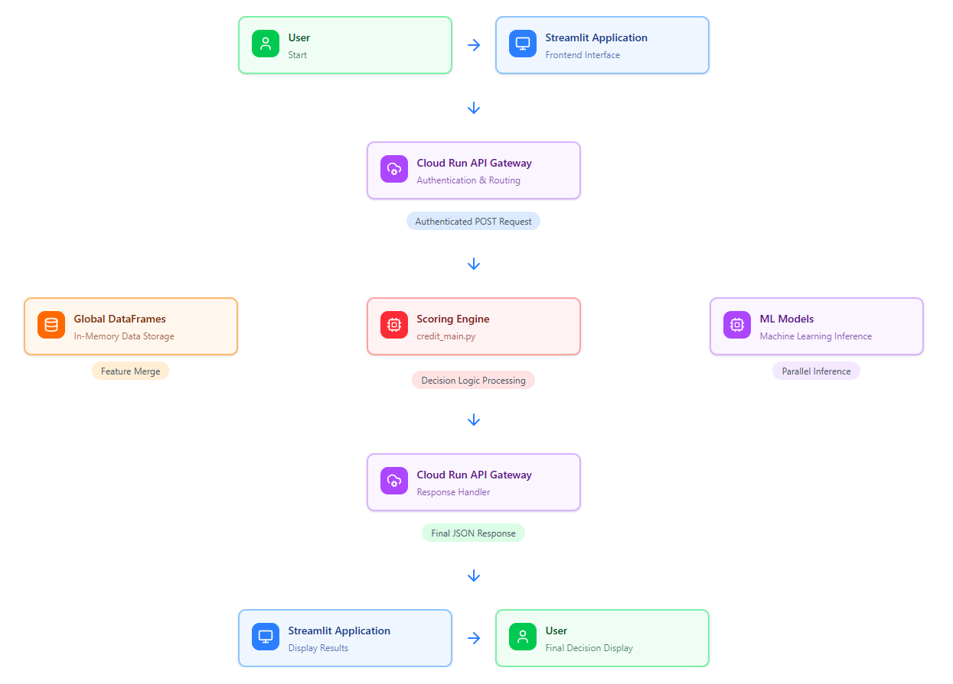
Integrated System Architecture Diagram

Slide 36







Image Sources
https://png.pngtree.com/thumb_back/fw800/background/20251022/pngtree-digital-shield-with-circuitry-and-data-streams-on-a-dark-blue-image_19952571.webp
Source: pngtree.com
https://media.istockphoto.com/id/1249714483/vector/money-insurance-concept.jpg?s=612x612&w=0&k=20&c=EOPGuZEbp387JK-HichG4vqNu3G0l-OA1GfEsC-os8A=
Source: www.istockphoto.com
https://machinelearningmastery.com/wp-content/uploads/2018/08/ROC-Curve-Plot-for-a-No-Skill-Classifier-and-a-Logistic-Regression-Model.png
Source: machinelearningmastery.com
https://www.mdpi.com/ijfs/ijfs-13-00132/article_deploy/html/images/ijfs-13-00132-g001-550.jpg
Source: www.mdpi.com
https://images.stockcake.com/public/8/1/e/81e1bd0c-78ac-497e-96e9-dafdaf2fc0ff_large/secure-vault-door-stockcake.jpg
Source: stockcake.com

Slide 37
Questions?
Thank you for your attention!

